Slide 1
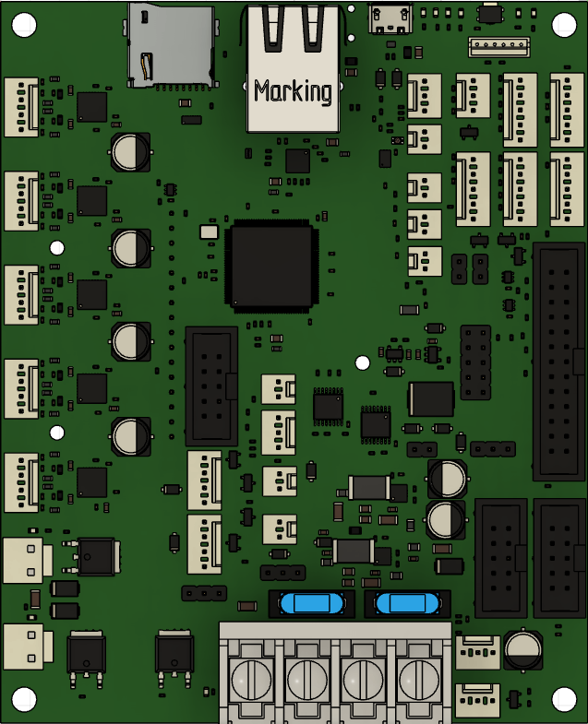
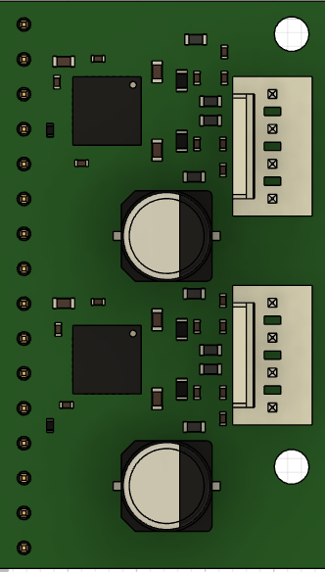
5 Axis Additional Wiring into Stepper Driver
Z Right
Filament Runout sensor
E
Bed Thermistor
Hotend Thermistor
Y
C
X
B
Z Left
Noctua (Hotend) Fan
Part Cooling Fan
HOTEND
BED
12V In

Slide 2
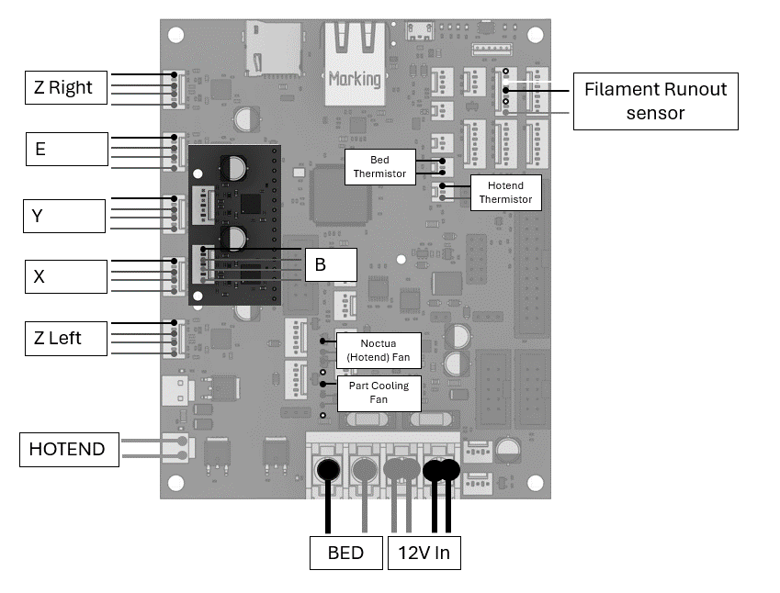
5 Axis Additional Wiring into Stepper Driver
C

